Slide 1
DSAI MINOR COURSE PROJECT
FACIAL EMOTION RECOGNITION USING MOBILENET
BY- APOORVA NEHA, SUBHASHREE KEDIA, SAMRIDDHI VARSHNEY

Slide 2
FER
Facial Emotion Recognition (FER) analyzes emotions through facial expressions, enhancing interactions in areas like mental health, robotics, and entertainment.
This project focuses on creating a real-time FER system optimized for mobile devices
APPLICATIONS
1. Mental health & accessibility: Track mood patterns and assist in interpreting emotions.
2. Customer insights: Gauge real-time reactions in service, market research, or dating apps.
3. Safety: Detect driver drowsiness and nearby emotional threats.
4. Adaptive UIs & gaming: Adjust interfaces and gameplay based on user emotions.
5. Education: Help assess student engagement remotely.
In order to do this, we can use MobileNet which uses optimal techniques to reduce the operational cost.

Slide 3
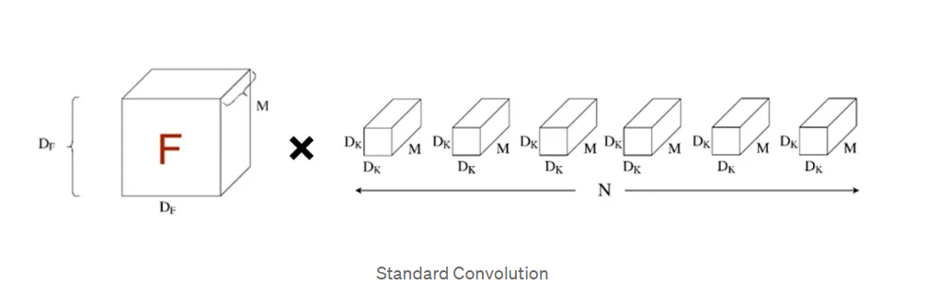
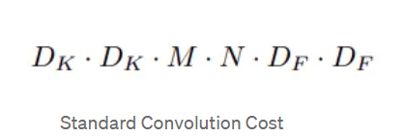
MOBILENET V/S CNN
MOBILENET | CNN
Fewer parameter count | Higher parameter count
Higher speed | Less speed
49% Accuracy | 51% Accuracy
Where Df is the special dimensions of the input feature map and Dk is the size of the convolution kernel. Here M and N are the number of input and output channels respectively
The computational cost depends multiplicatively on the number of input and output channels and on the spatial dimensions of the input feature map and convolution kernel.

Slide 4
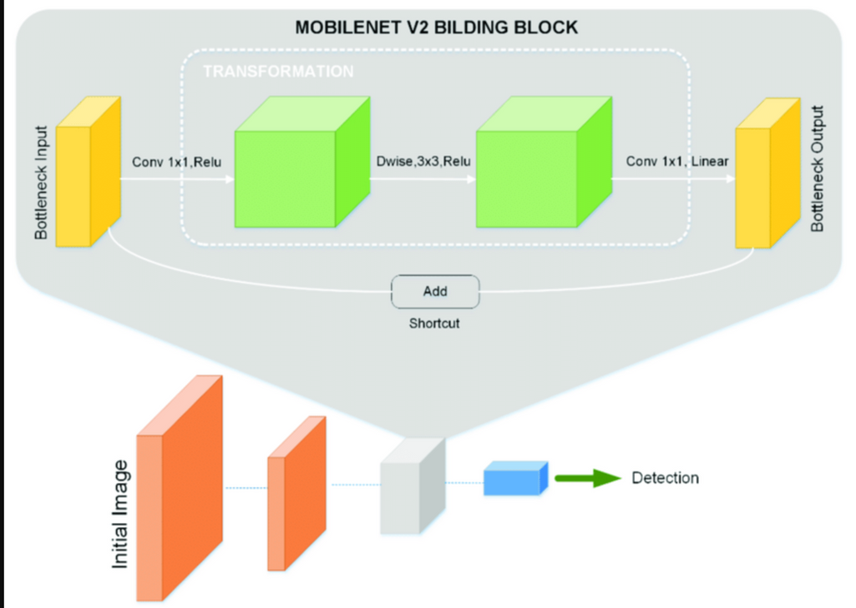
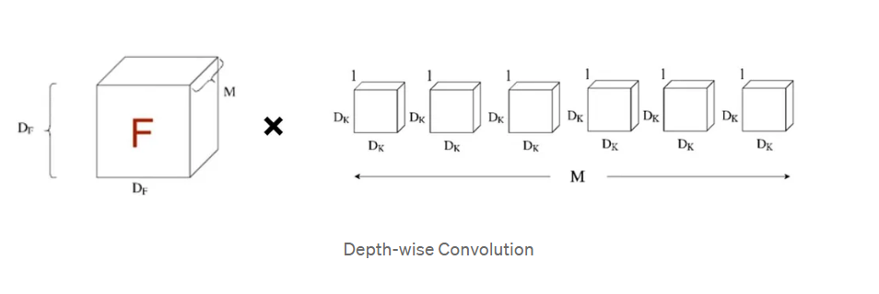
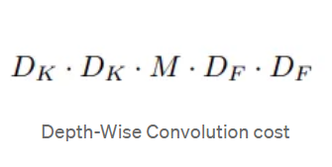
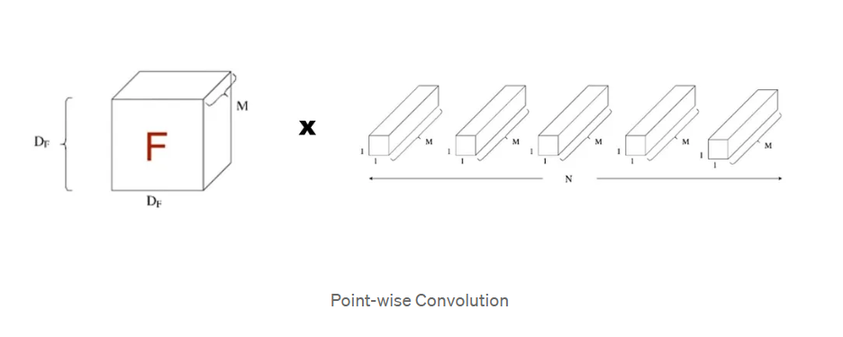
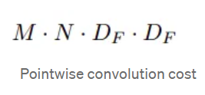
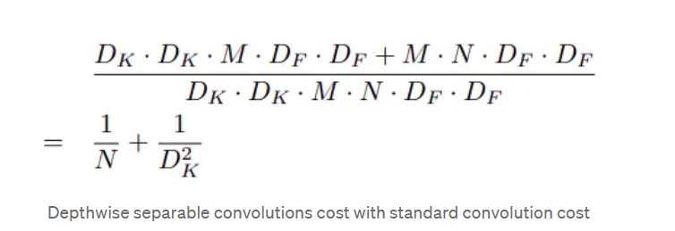
MOBILENET
Incase of depthwise convolution, as seen in the below image, contains an input feature map of dimension DF*DF and M number of kernels of channel size 1.
Comparing it with the computational cost with standard convolution, we get a reduction in computation, which can be expressed as:
Pointwise convolution layer is made, which computes a linear combination of the output of depthwise convolution using a 1 × 1 convolution.

Slide 5
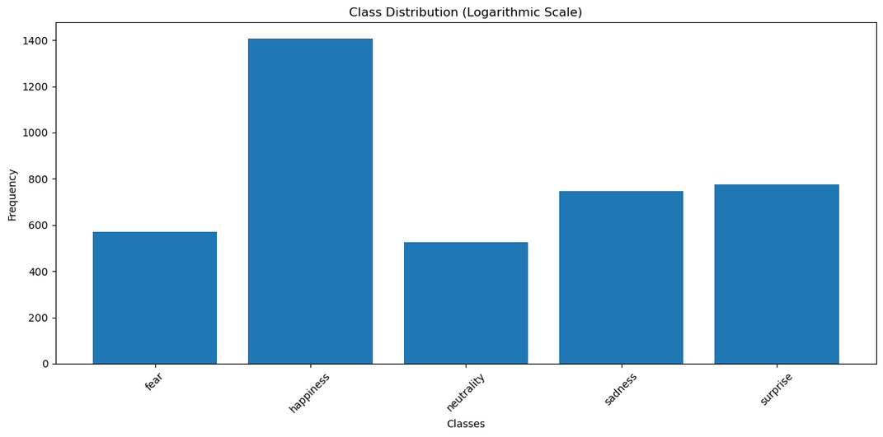
DATA PREPROCESSING
To address class imbalance, we applied class-wise data augmentation to increase the sample size for underrepresented classes, setting a threshold of 1000 images per class. Using PyTorch's `transforms` library, we created a pipeline with the following augmentations:
RandomHorizontalFlip: Randomly flips images horizontally.
RandomRotation: Rotates images by up to 30 degrees.
ColorJitter: Adjusts brightness, contrast, saturation, and hue.
RandomResizedCrop: Crops and resizes images
Final Preprocessing for MobileNet:
Converted Images from grayscale(as provided in dataset) to RGB channels
Converted to Tensor
Normalised in the end for the final processing.
Heavily Imbalanced Class Distribution

Slide 6
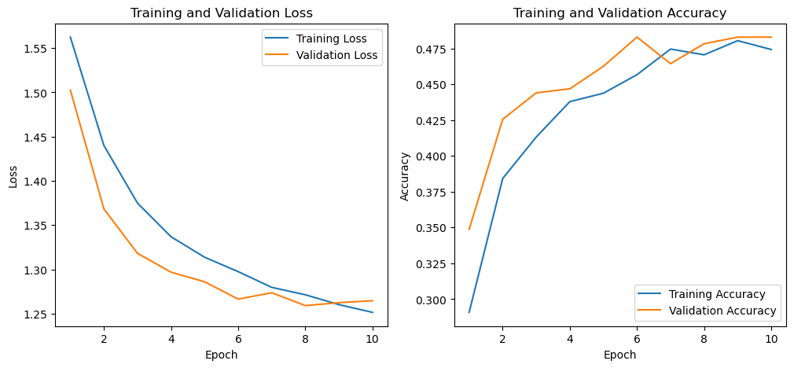
MODEL FLOW
Pretrained
Model Architecture
(parameters freezed)
Final
Classification Layer to map the output
Added Optimizer to adjust classifier parameters
We calculated Losses from Cross Entropy Loss Function
For our classification task we customized MobileNet’s final layer to match the number of output classes getting an accuracy of 49%.
We also tried to add 3 layers with activation function: RELU, along with Dropout of 30% neurons,
getting a lesser accuracy of 48%.

Slide 7
CHALLENGES ENCOUNTERED
INEFFECIENT CLASS ENCODING
VERY LARGE CLASS IMBALANCE
APPROPRIATE LEARNING RATE
We added an extra softmax layer which skewed the mapping
Resolution-
Addition of a classifier layer which maps
Class-wise Data augmentation for some classes made the model overfit.
Resolution-
We dropped them
We tried to raise the learning rate to 0.01 but it couldn’t find the parameters, so accuracy decreased.
Resolution-
We decreased learning rate to 10^-4.

Slide 8
FUTURE WORK
Employing better techniques for proper finetuning of the model using StreamLit library.
Dataset Expansion: Enhance FER datasets to include diverse cultural and demographic expressions
Adaptive Learning Techniques: Implement adaptive learning for mobile FER systems to enable continuous updates based on new data
Optimization for Edge Devices: Further optimize MobileNet for deployment on resource-limited edge devices using techniques like model quantization,
Multimodal Emotion Recognition: Integrate visual data with audio or physiological signals for a comprehensive understanding of emotions, improving accuracy in complex scenarios.

Slide 9
THANK YOU

